Slide 1
Supplier 360 Instructions
November 2024

Slide 2
Table of Contents
Password set-up and logging in
Recommended Browsers
Supplier Homepage
Lite vs Full Onboarding
Lite Onboarding
Full Onboarding
Account Tab
Contacts Tab
Sites Tab
Questions Tab –Conflict Minerals
Attachments Tab
Submitting
Representations and Certification
Chatter
Questions

Slide 3
Welcome to Supplier 360!
Welcome to Supplier 360, the GDMS Supplier Portal.
From within this portal, Suppliers will be able to:
Manage their information
Submit Representations and Certifications
Respond to Requests for Quotes
Respond to Corrective Action Requests
Communicate with GDMS personnel via the “Discussion” (Chatter) feature.

Slide 4
Password set-up and logging in
When you receive your S360 e-mail invite from Salesforce, it will contain 2 links
One link will be to set up your S360 Password
One link will be for our Supplier 360 page where you can find instructions and a link to the S360 log in page
Password requirements are as follows:
8 characters minimum
Must include numbers, upper and lower case letters, and special characters
Password should not contain the word “Password”
Once your password has been created, the login page for the next time you log in will be:https://gdms.my.site.com/SupplierForce

Slide 5
Recommended Browsers
Supplier 360 works best with the following browsers:
Google Chrome
Microsoft Edge
Mozilla Firefox

Slide 6
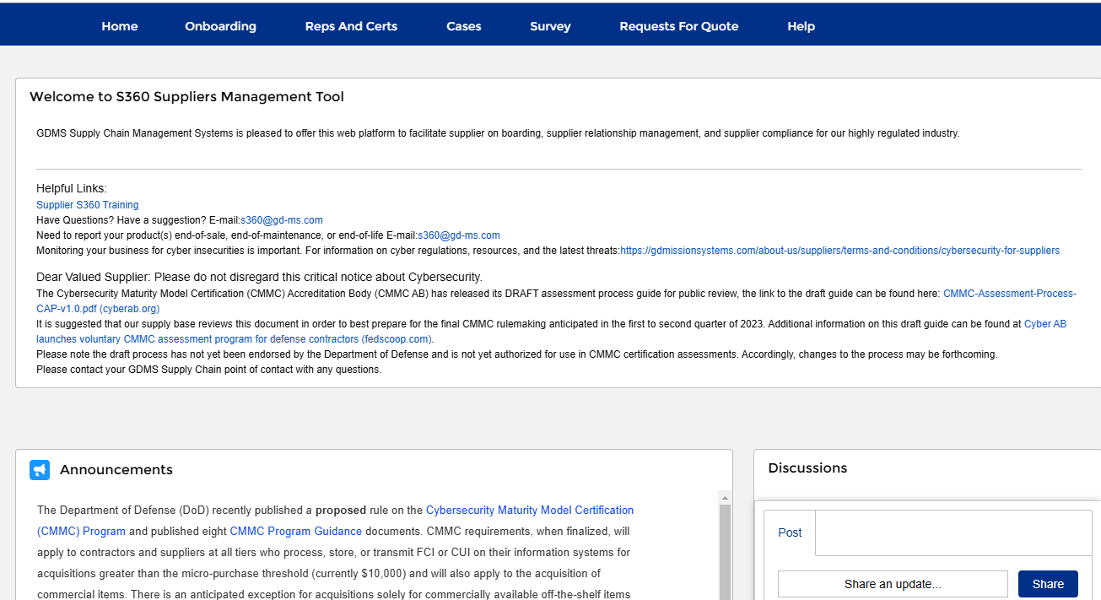
Supplier Homepage
1
When you log into S360, you will be brought to your Supplier Homepage. On this page you will find:
Links to the following tabs where you will provide info as required
Onboarding (Your company’s information)
Reps and Certs
Cases – Used for corrective action requests
Survey
Request for Quote
“Helpful Links” to Training, Cybersecurity information and the e-mail address for our S360 support.
“Discussions” chat window where you can chatter and with your GD points of contact.
Announcements
2
4
3

Slide 7
Lite vs Full Onboarding
We have 2 types of Onboarding:
Lite Onboarding – for Suppliers we wish to send Request for Quotes or Request for Information to, but are not yet required to go through the full GDMS approval process.
Lite Onboarded Suppliers may be asked to go through the full approval process at a later date, if selected for a purchase order/proposal effort.
Full Onboarding – For Suppliers we will be issuing orders to which requires additional account details and our full approval process

Slide 8
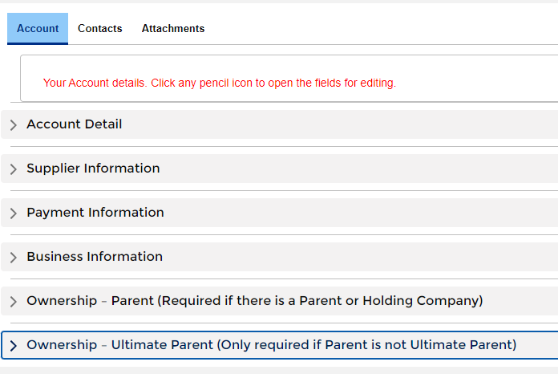
Lite Onboarding
If you are being asked to Lite Onboard, you will see only 3 Tabs in the onboarding section:
Account
Contracts
Attachments
If you see more than three tabs, you are being asked to complete a full onboarding which will require approval. Skip to slide 11 for instructions.
To view each section, click the arrow to the left of each section

Slide 9
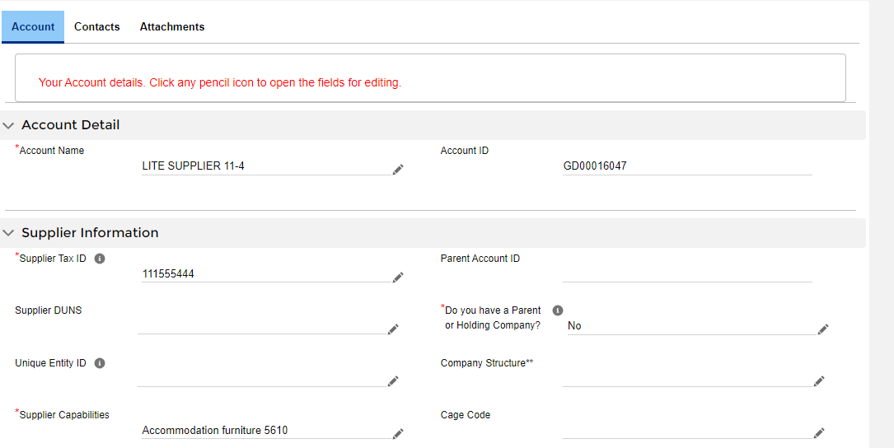
Account Tab –Lite Onboarding
To Start entering your information on the Account Tab, click any pencil icon on the screen. This will open the fields for editing
Fields with an asterisk are required. But you should answer all other questions that are applicable. When you have completed all required fields hit “Save”
If you select “yes” to the question “Do you have a Parent or Holding Company” there are additional required fields that you need complete in order to save. These fields are at the bottom of the page and are marked with a double asterisk.
If you do not have the information to complete these fields but want to be able to enter and save other information on this tab, leave this field as “NONE” until you have the necessary data. This will allow you to save the other information
1
2
3

Slide 10
Attachments – Lite Onboarding
On the “Attachments” tab, please upload either a W8 or W9 as applicable
You can also upload any quality certifications you have.
If no certs are uploaded during lite onboarding, they may be requested at a later date as part of the full onboarding process.

Slide 11
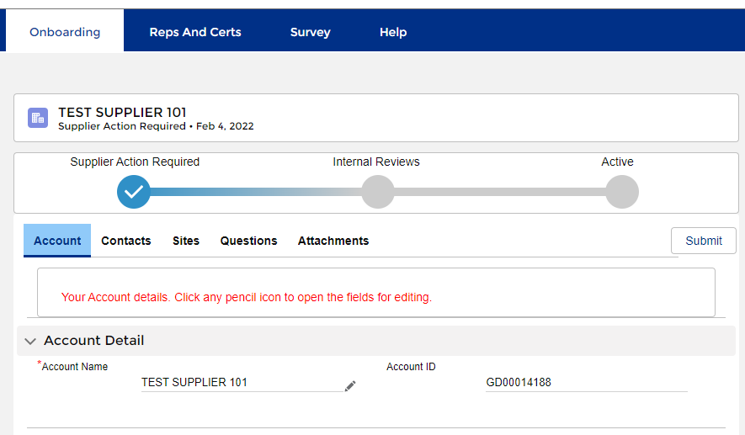
Full onboarding
The “Onboarding” tab is where you will fill in all of the information General Dynamics Mission Systems will need to approve your account.
At the top you will see a status bar. This will tell you what stage of the approval process your account is in.
There are 5 tabs that need to be completed for the onboarding process.
When you have completed the information on all of the tabs, you will use the “Submit” button to submit to General Dynamics
1
2
3

Slide 12
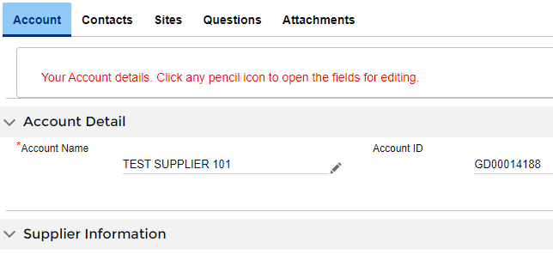
Account Tab
To Start entering your information on the Account Tab, click any pencil icon on the screen. This will open the fields for editing
Fields with an asterisk are required in order to submit. But you should answer all other questions that are applicable. You will be able to save your progress but will be unable to submit until all required fields are complete.
If you select “yes” to the question “Do you have a Parent or Holding Company” there are required fields that you need to select in order to SAVE. (see next slide for a listing of these fields). If you do not have the information to complete these fields but want to be able to enter and save other information on this tab, leave this field as “NONE” until you have the necessary data. This will allow you to save the other information
1
2
3

Slide 13
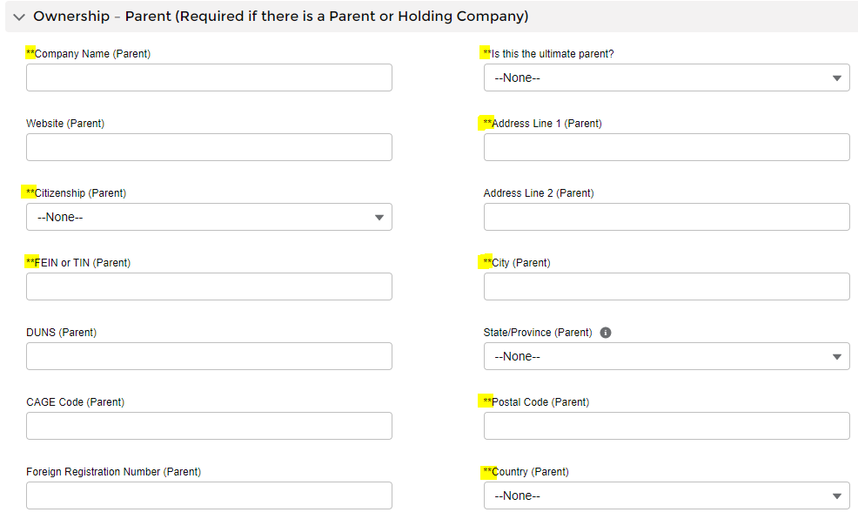
Account Tab
If you select “YES” to the question ““Do you have a Parent or Holding Company” the fields marked with Double asterisk before the field name, are required to save.
Note: If you select “Foreign” for “Citizenship (Parent)” then a “Foreign Registration Number” is also required.
If you select “NO” for the question “Is this the ultimate parent?”, then you will be required to complete these same fields in the “Ownership – Ultimate Parent (section)

Slide 14
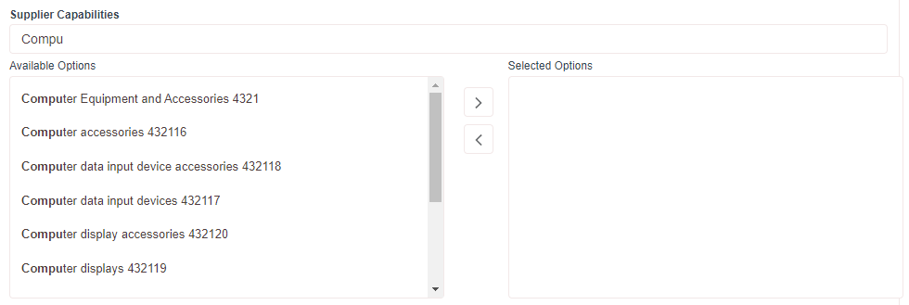
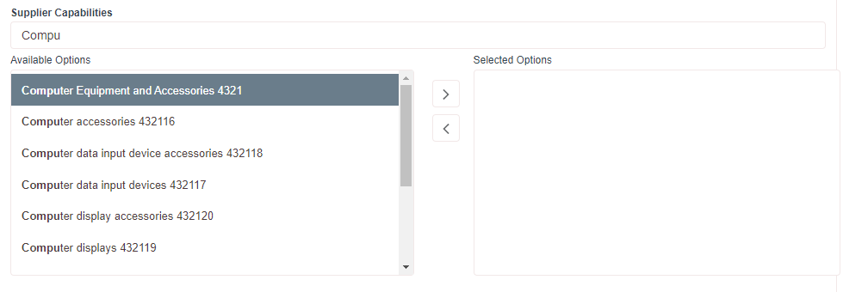
Account Tab
4
4. To fill in the “Supplier Capabilities” and “NAICS Codes”, start typing a category in the field above the available options. In this example, the start of the word “computers” has been entered. The available options list will jump to the first entry that contains that word.
5. Highlight the applicable category and click the right arrow to move it to the “Selected Options” box.
You can select as many categories as applicable.
5

Slide 15
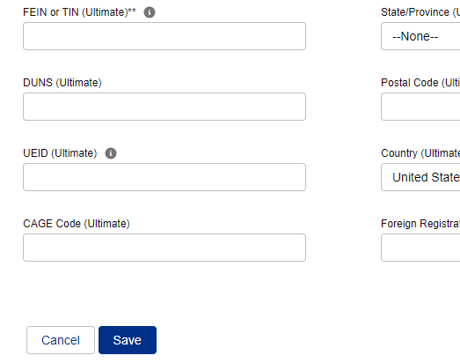
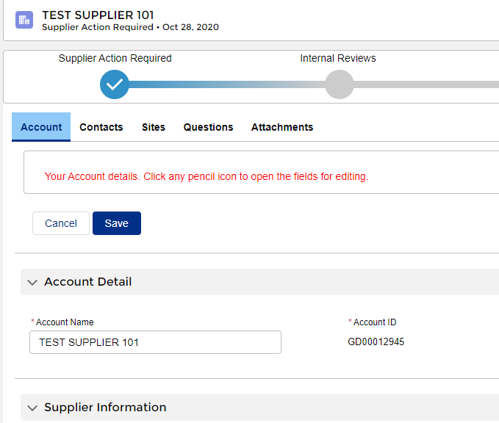
Account Tab
6. When you have filled in all of the required fields, click the “Save” button.
7. Then scroll back to the top of the page and click the “Contacts” tab to move on.
6
7

Slide 16
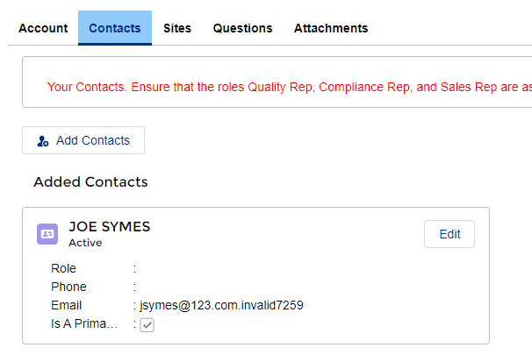
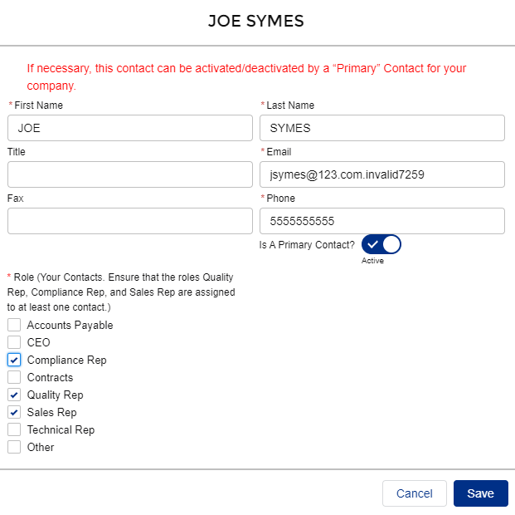
Contacts Tab
A window will pop up allowing you to edit and update your information. Be sure fields with an asterisk are completed
2. As the initial Point of Contact, you will default to the “Primary” contact. You can change this, as necessary, after you assign more contacts. But there must be at least 1 primary contact assigned. Primary Contacts have the ability to edit the account info. There can be more than one per account
3. The following “Roles” must be assigned to someone in order to submit your information back to GD.
Compliance Rep
Quality Rep
Sales Rep
The roles can be assigned to one person, or split up among multiple POCs. But all roles must be assigned at time of submittal
4. When you are done, click “Save”
1
2
3
1. Click the “Edit” button to edit your contact information
4

Slide 17
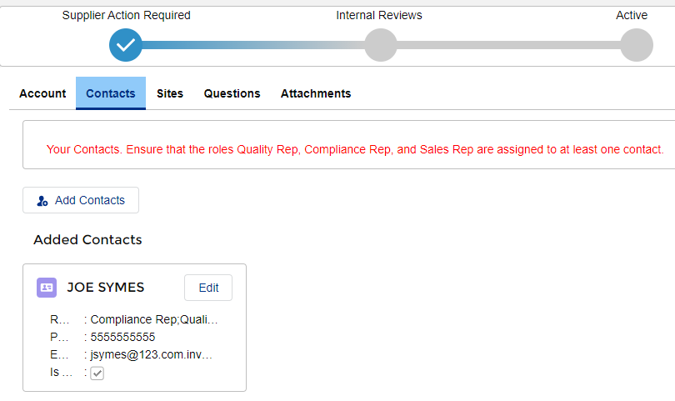
Contacts Tab
You will be brought back to the main Contacts screen.
5. If you have additional contacts to add, click the “Add” Contacts” button.
6. If you have no additional contacts to add, click the “Sites” tab to move on.
6
5

Slide 18
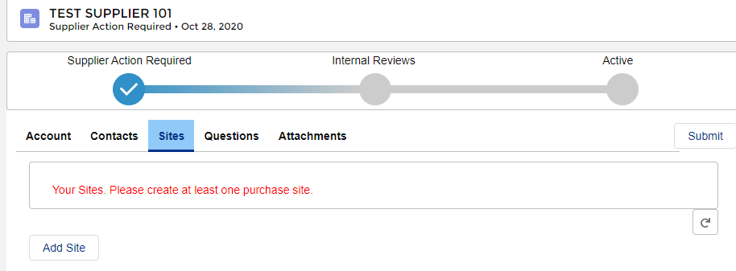
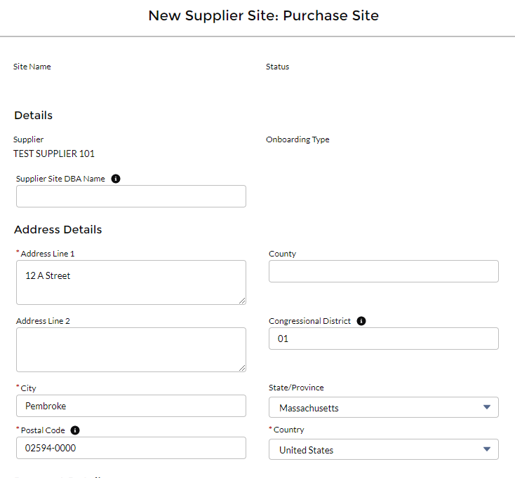
Sites Tab
2. Fill in your information. Be sure all fields with an asterisk are completed.
3. Note: Postal code must be in format zip+4. You can look up postal codes here: https://tools.usps.com/zip-code-lookup.htm
1
2
1. When you are brought to the sites screen, click “Add Site”.
3

Slide 19
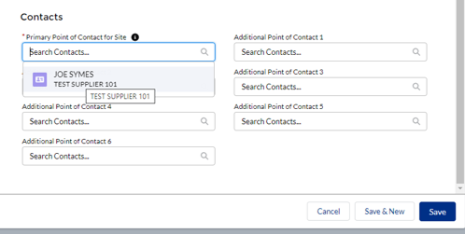
Sites Tab
4. You must select “yes” or “no” for the question “Does site outsource for special process? (Do not leave as NONE)
Down at the bottom of the screen, you will need to assign a point of contact for your site. You can assign multiple contacts however they have to be added as a contact on the “Contacts” tab first.
5. To assign a contact, click in the “Primary Point of Contact for Site” field
6. When you do this, the name will appear in a drop down menu. Click on it to select
7. When you are done scroll to the bottom of screen and hit “SAVE”
4
5
6
7

Slide 20
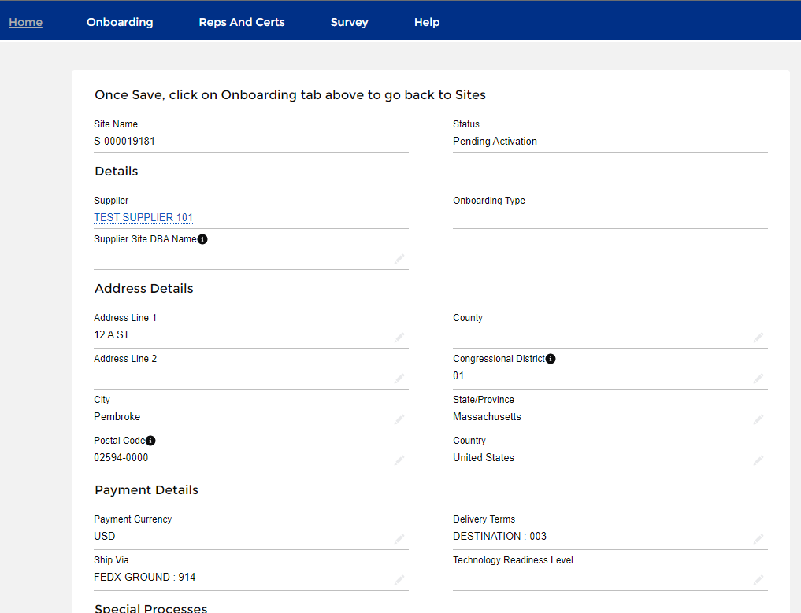
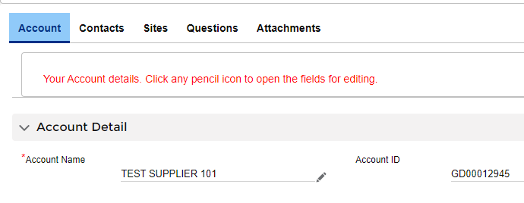
Sites Tab
8
8. Once you save your address, you will be brought to a page to review your entry. Click “Onboarding” to return to the main account screen.
9. Then click the “Questions” tab or if you have more sites to enter click the “Sites” tab again.
9

Slide 21
Questions Tab –Conflict Minerals
Why do we request this information?
The SEC requires us to report annually if we have conflict minerals in our products. We are required to check with our supply base in order to be able to do this. These questions help us fulfill this requirement. Conflict minerals include tin, tantalum, tungsten and gold. If any of these are in the product being provided we need to know where they originate from.
The onboarding question has options for when it is not applicable too. Please certify to the option that best applies. The options are:
NO 3TG MINERALS SOURCED FROM COVERED COUNTRIES
3TG MINERALS SOURCED FROM COVERED COUNTRIES, BUT ARE NOT CONFLICT MINERALS:
CONFLICT MINERALS SOURCED FROM COVERED COUNTRIES:
NOT APPLICABLE (NO 3TG IN MATERIALS OR PRODUCTS):
NOT APPLICABLE (SERVICES PROVIDED ONLY):

Slide 22
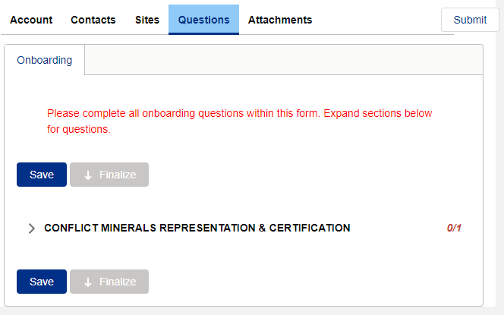
Questions Tab - Conflict Minerals
You will be brought to a page to answer a question regarding Conflict Minerals
The number on the right indicated how many questions have been answered and how many questions there are. In this example, there is one question, and it has not been answered yet
Click the arrow to expand the question.
1
3
2

Slide 23
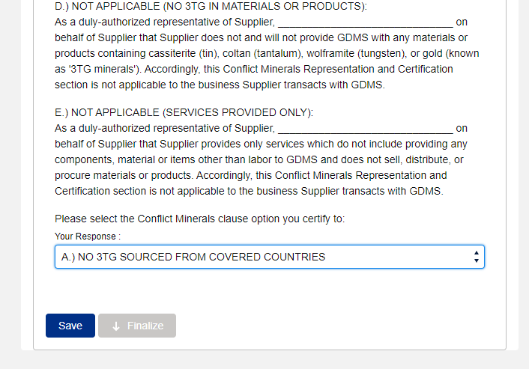
Questions Tab - Conflict Minerals
4
4. Read through the possible responses
Select the response you want to certify to.
Click “Save”
7. Click “Finalize”
5
6
7

Slide 24
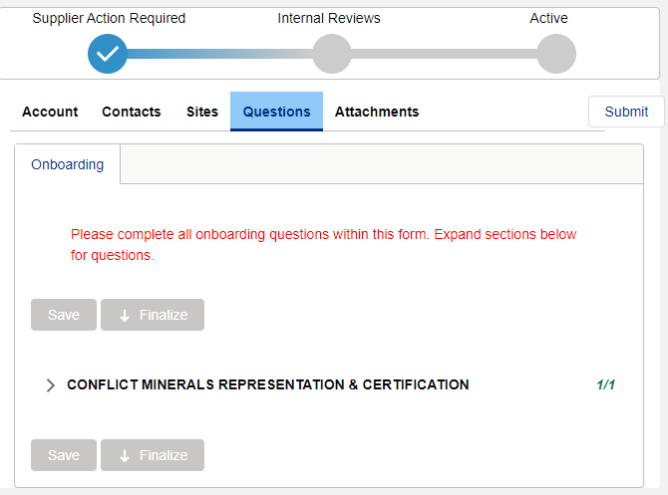
Attachments Tab
Now you need to attach some documentation required by GDMS to activate your account.
Click the “Attachments” tab.

Slide 25
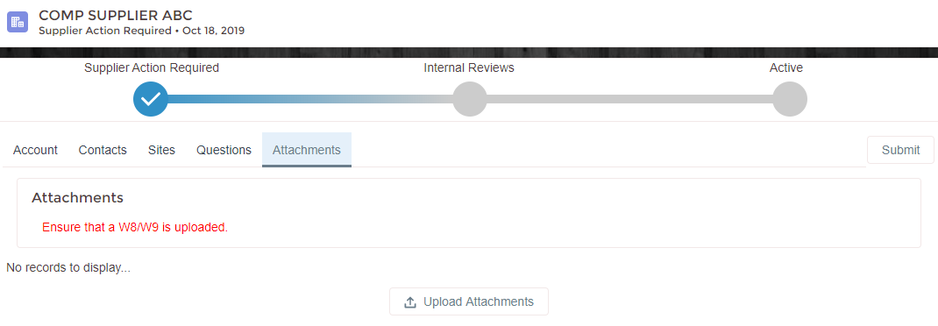
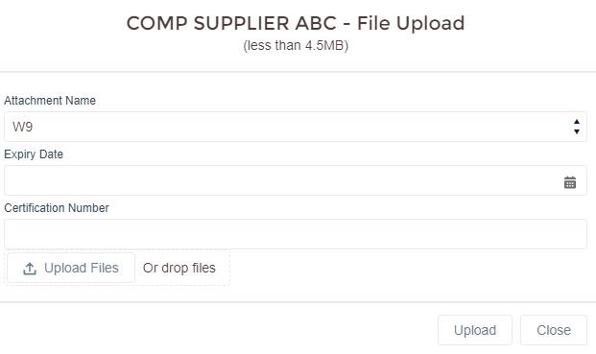
Attachments Tab
At a minimum, you will need to upload either a W8 or W9. However, we recommend if you have any third party certifications (i.e. ISO, AS or NADCAP) you upload those as well. This will speed up the quality review process, as our team will not need to reach back to you to request the documents.
To upload your documentation:
Click “Upload Attachments”
When the file upload screen pops up, Select the appropriate “Attachment Name” from the drop down menu.
Fill in “Expiry Date” and “Certification Number” if applicable.
Click “Upload Files” and search for your document on your desktop.
Click “Upload”
1
2
3
4
5

Slide 26
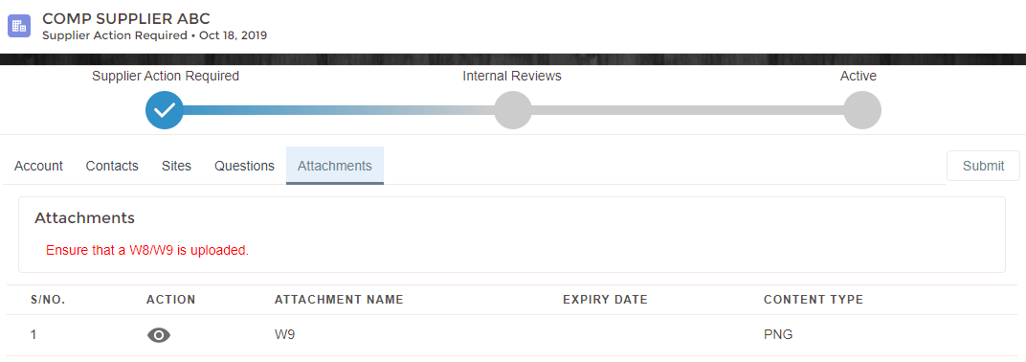
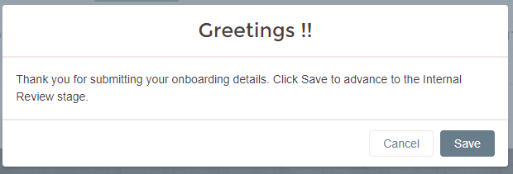
Submitting
When you have uploaded all your necessary attachments, click “Submit”. (Ensure info on all other tabs, including Reps and Certs, is completed, if required)
You will receive a message indicating the form was submitted. Click “Save”
You should receive a message at the top of your screen indicating the form was submitted successfully.
1
2
3

Slide 27
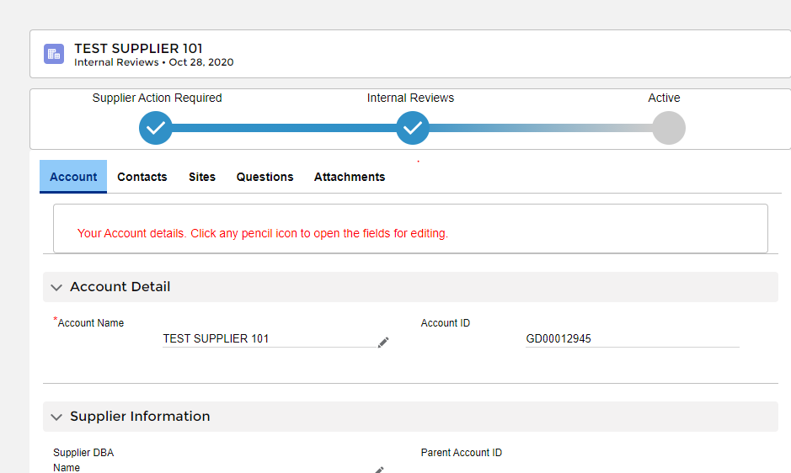
Submitting
Now, if you navigate back to your account screen and refresh your screen, you will notice the status has moved to “Internal Review”. This means it is in the approval queues of the GDMS Compliance and Quality teams.
Please continue to the next slides to see how to submit reps and certs (if required) and how to “chatter” with your GD Point of Contact.

Slide 28
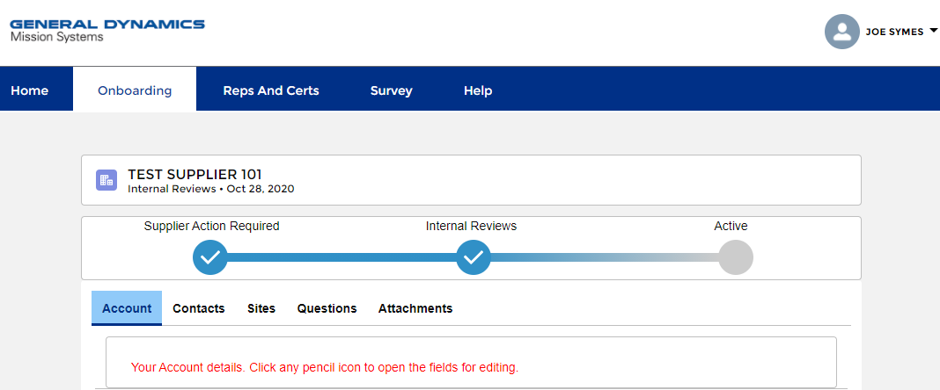
Reps and Certs
Note: If you are not the person who will be completing the reps and certs, you can add the correct person as a contact on the “Contacts” tab (see slide 12) and they will receive an invite to the system.
You will want to notify that person to complete the reps and certs
Now you need to check if GDMS has requested that you complete annual representations and certifications (reps and certs). To do this, click the “Reps and Certs” tab at the top of the screen.
Reps and certs do not have to be complete in order to submit your other information. However, in some cases we may not be able to award a purchase order/subcontract to you until they are completed. If requested, we do ask that you complete them as soon as possible.

Slide 29
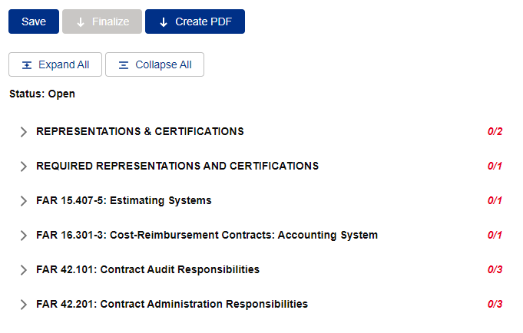
Reps and Certs
You can see how many questions there are in each representation/certification and how many you have completed to the right of the category.
To expand all representations/certifications click the “Expand All” button at the top

Slide 30
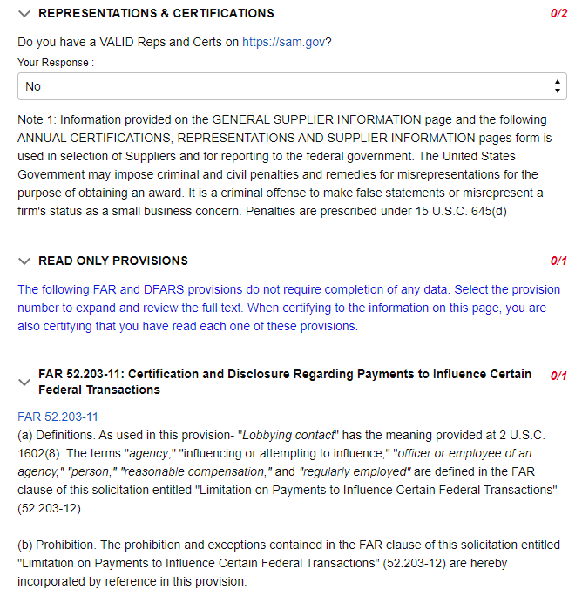
Reps and Certs
If you answer “No” to question “Do you have VALID Reps and Certs on https://sam.gov” the clauses FAR 52.203-11 through DFAR 252.247-7023 are READ ONLY Provisions.
These clauses do not require completion, however when certifying to the information on this tab you are also certifying that you have read each of these provisions.
The response count on the right for “read only” clauses and notes will automatically update to show these are complete when you hit “SAVE”.

Slide 31
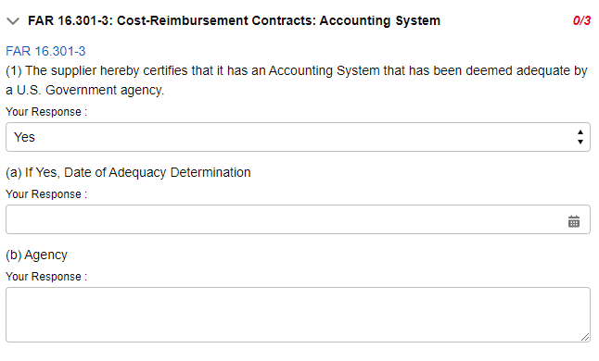
Reps and Certs
Some of the questions have dependencies, so depending on how you answer a question, more questions may appear (see example)

Slide 32
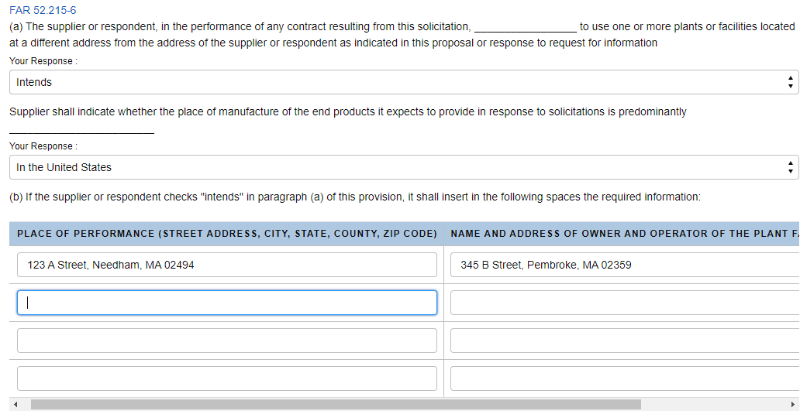
Reps and Certs
Some questions have a table for you to complete. In some case, you may not need to use all the rows to provide your information. Only the first row of a table needs to be complete to submit you information.
If there is a table question that does not apply to you, enter “NA” in the fields on the top row to complete.

Slide 33
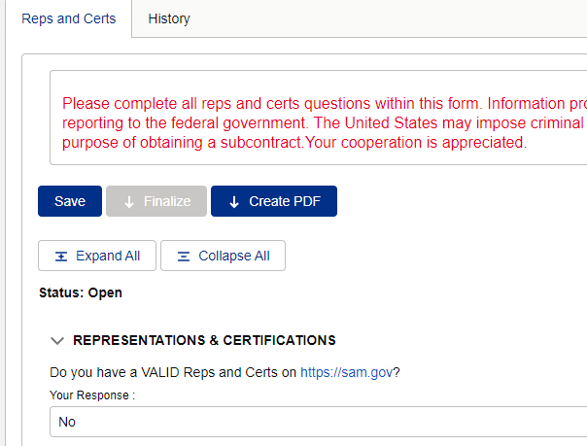
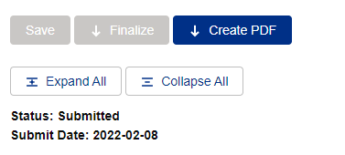
Reps and Certs
You can save at any point while filling out the form to come back in and complete later, by hitting either the “Save” button at the top or bottom of the screen. It is recommended that you save a couple times while filling out the form to ensure you don’t lose responses in the event of a lost internet connection.
When you have answered all the questions, click “Save” then “Finalize” at either the top or bottom of your screen.
IMPORTANT – Your Reps and Certs will not be submitted to GDMS Compliance for review until you hit “Finalize”.
The status at the top of the page will change to “Submitted” and the date of the submittal will be populated
1
2
3

Slide 34
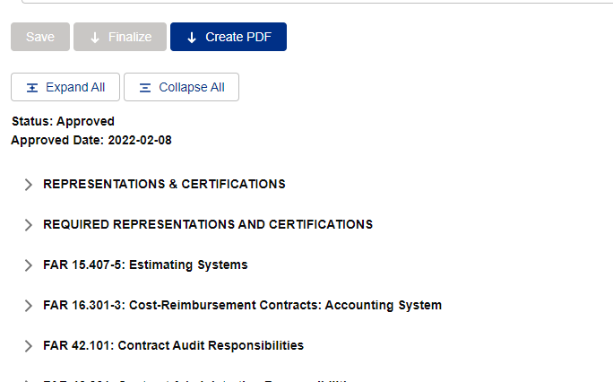
Reps and Certs
Once your Reps and Certs have been approved, the “Status” at the top of the Reps and Certs page will change and the “Approved Date” will be populated
If you would like a PDF version of your certs, click the “Create PDF” button at the top
2
1

Slide 35
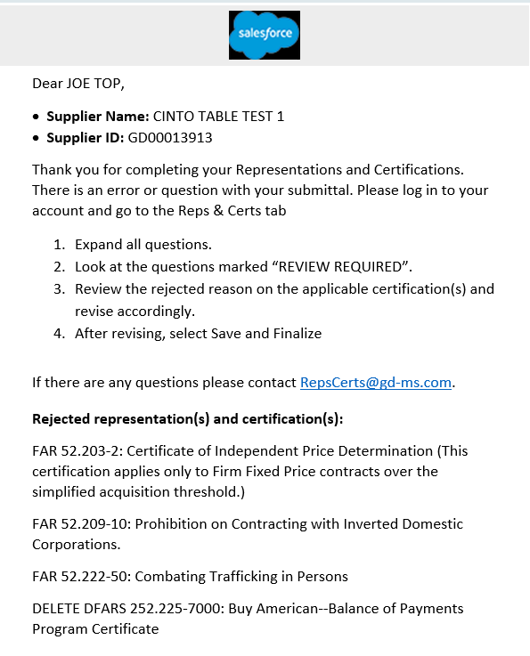
Reps and Certs
If the GDMS Compliance team has any questions about how you answered certain representations and certifications, they may reject those questions with comments, and you will receive an e-mail.
The e-mail will contain:
Directions on how you should proceed
A link to for you to contact the Compliance Team with any questions
A list of the rejected questions.
Please log back into your account, go the “Reps and Certs” tab and update any responses as necessary.
When you are done, click “Save” and then “Finalize” to resubmit.
PLEASE NOTE – you are not required to change your response. If there are no changes to be made, just click “Save” then “Finalize to resubmit. A compliance team member may need to follow up with you for an explanation. Or you can e-mail comments back using the e-mail address provided, if necessary
1
2
3

Slide 36
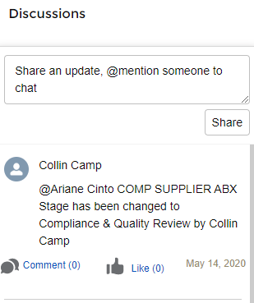
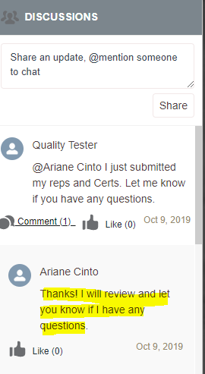
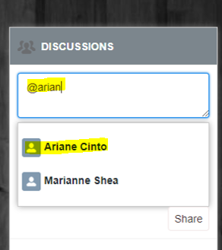
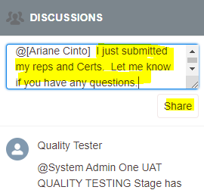
Chatter
On your home page, you will see “Discussion” box. This is an instant messaging feature that will allow you to communicate with your GD POC. On the GD internal site, this is referred to as “Chatter”
To “chatter” with your GD POC, type “@” and then start typing the POC’s name. When their name appears in the drop down, click to select it.
Type your message and then click “Share”
Your POC will receive an e-mail that you have sent them a message
You will receive an e-mail when they respond, and it will appear in your discussion thread.

Slide 37
Questions
If you have any questions, please send and e-mail to S360@gd-ms.com
Please visit our website: https://gdmissionsystems.com/about-us/suppliers/s360
Thank you!

